Slide 1

2025/12/2
ECHOES OF THE VOID
A THIRD-PERSON EXPLORATION & SURVIVAL PUZZLE GAME
PREPARED BY ECHO
COMP4122
PAGE 1

Slide 2
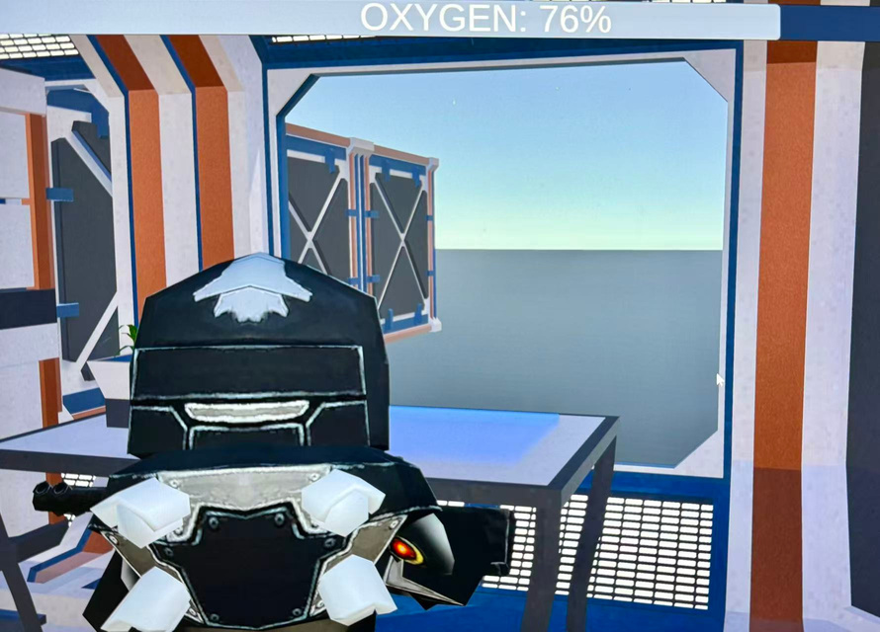
2025/12/2
The Premise
Alone in the Silence
You are the sole survivor on a critically damaged spaceship drifting in the void.
Your goal is simple yet desperate: repair the ship and navigate your way back to Earth.
However, you are not entirely alone. The story of what happened and the fate of a fellow crew member unfolds through the clues they left behind.
PREPARED BY ECHO
PAGE 2

Slide 3
2025/12/2
Core Gameplay Loop
Explore, Scan, Repair, Survive
Third-Person Exploration: Navigate the immersive, atmospheric interior of your broken ship.
Scan Damaged Modules: Use a scanner to identify critical system failures (Oxygen, Navigation, Power, etc.).
Engaging Mini-Games: Enter a unique puzzle interface for each module to perform repairs.
Key Visual: A diagram showing the cycle: Explore -> Scan -> Mini-Game -> Repair -> Progress.
PREPARED BY ECHO
PAGE 3

Slide 4
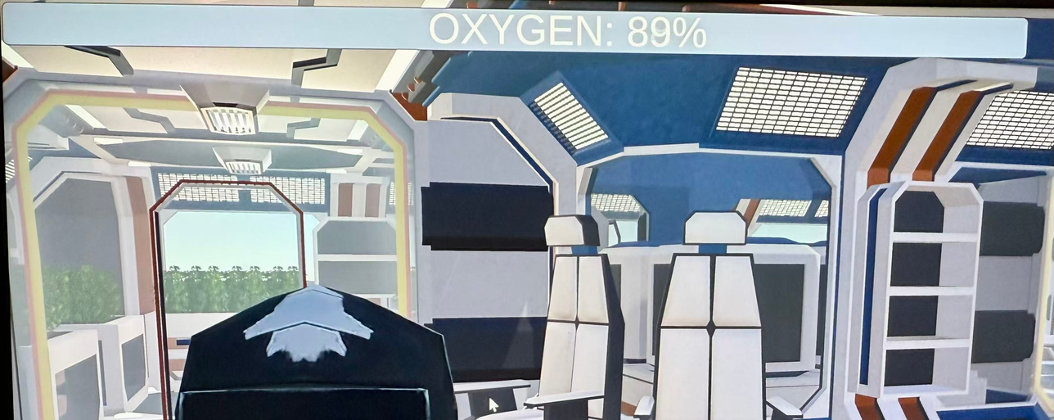
2025/12/2
The Oxygen Mechanic
Your Most Precious Resource
Oxygen is a finite resource that depletes over time in each chapter.
Standard Actions: Walking consumes oxygen slowly.
Strenuous Actions: Lifting heavy objects or repairing systems consumes oxygen more quickly.
Consequence: Running out of oxygen forces a restart from the beginning of the chapter, encouraging careful planning and efficient pathfinding without excessive frustration.
PREPARED BY ECHO
PAGE 4

Slide 5
2025/12/2
Genre & Atmosphere
Headline: Psychological Tension, Not Jump Scares
Content:
Genre: 3D Third-Person Exploration Puzzle.
Atmosphere: Survival Horror-inspired tension, focused on resource pressure and isolation.
No Combat, No Monsters: The horror comes from the environment, the ticking clock of your oxygen, and the haunting narrative.
Perfect Fit: A "walking simulator with puzzles," designed to be a sharp, impactful indie experience.
PREPARED BY ECHO
PAGE 5

Slide 6
2025/12/2
Visual & Audio Style
A Gloomy, Sci-Fi Aesthetic
Visuals: Realistic sci-fi style. A wasteland of a ship - flickering lights, steam leaks, and damaged panels.
Audio: A subtle, immersive soundscape with low-pitched ambient sound effects and a slow, heartbeat-like musical score to heighten tension.
Journal & Clues: Rendered in handwritten fonts. Black and white stick figures are deliberately rough, creating a personal, "found diary" feel.
PREPARED BY ECHO
PAGE 6

Slide 7
2025/12/2
Unraveling the Mystery
The Story You Uncover
Primary Goal: Repair the ship and return to Earth.
Secondary Narrative: Discover clues left by a crew member who died before your awakening.
Player's Quest: Piece together the events that led to the catastrophe and understand the final actions of your former colleague, revealed through audio logs, scrawled notes, and environmental storytelling.
PREPARED BY ECHO
PAGE 7

Slide 8
2025/12/2
Why It Stands Out
A Compelling, Focused Experience
High-Stakes Puzzles: Repair mini-games are directly tied to survival.
Innovative Resource Management: Oxygen mechanics create constant, manageable tension.
Emotional Narrative: A poignant story of loneliness and hope, discovered organically.
Accessible Horror: Appeals to players who enjoy tension and atmosphere without traditional horror elements.
Satisfying Arc: A gloomy journey culminating in the hopeful goal of returning home.
PREPARED BY ECHO
PAGE 8

Slide 9
2025/12/2
THANKYOU
ECHOES OF THE VOID
Please get in touch if you have any questions or concerns about the game.
PREPARED BY ECHO
GAME PRESENT
PAGE 9

